Slide 1
General Employee Radiation Training (GERT)
Washington State University Radiation Safety Program

Slide 2
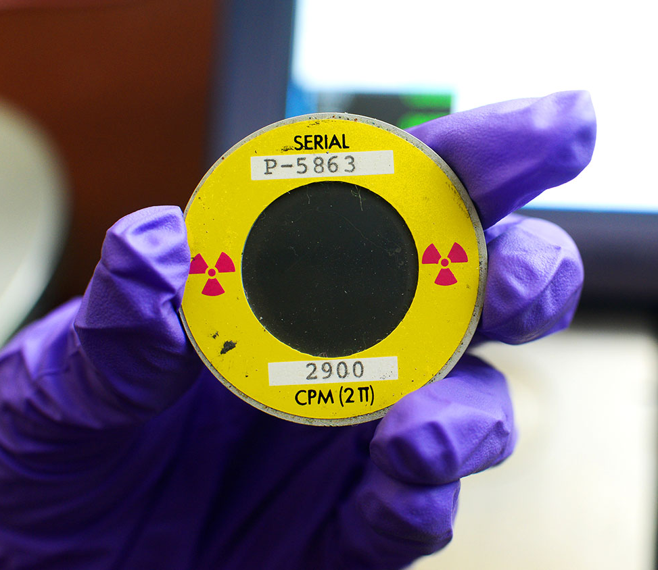
Welcome to General Employee Radiation Training
Welcome to GERT!
GERT is provided to all personnel who require unescorted access to laboratories and clinical areas where radioactive material or radiation producing devices are present.
This training does not authorize you to work directly with radioactive material or operate radiation producing devices.
This presentation will provide essential information to ensure your safety, health, and well-being when entering areas where radioactive material (RAM) or radiation producing devices are used.
Notes:
Welcome to GERT! GERT is provided to all personnel who require unescorted access to laboratories and clinical areas where radioactive material or radiation producing devices are present.
The training does not authorize you to work directly with radioactive material or operate radiation producing devices. This presentation will provide essential information to ensure your safety, health, and well-being when entering areas where radioactive material (RAM) or radiation producing devices are used.

Slide 3
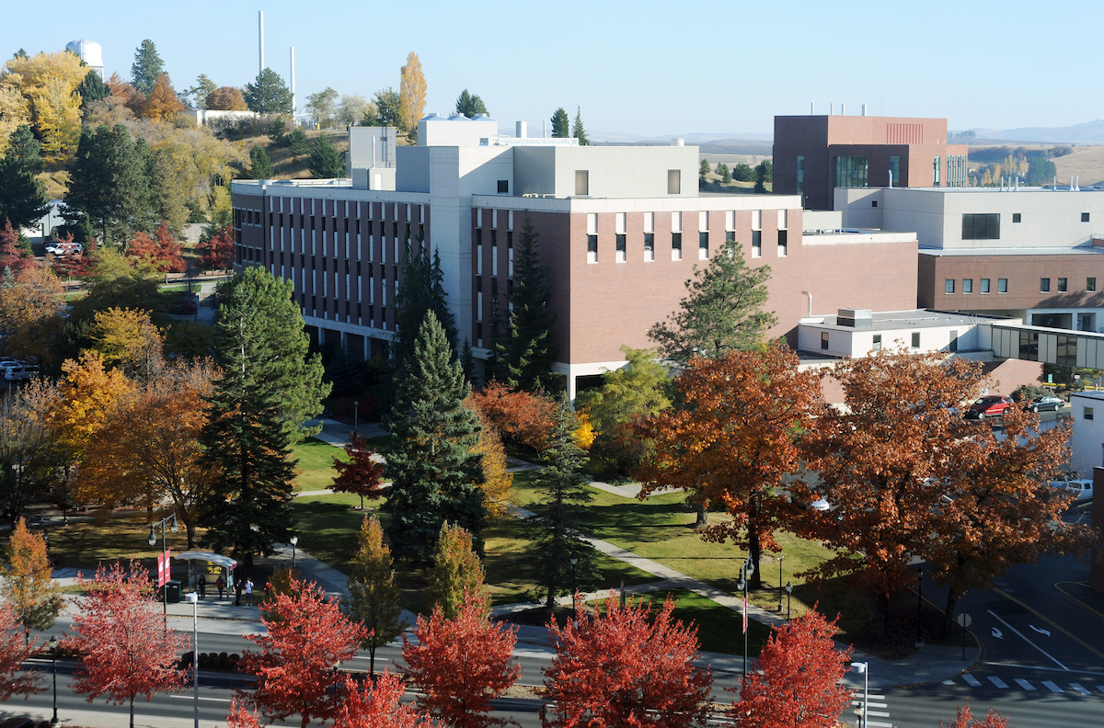
Radiation Safety at WSU
The Radiation Safety Program (RSP) works with numerous research groups, faculty members, and operations that use radioactive materials or x-rays across the state of Washington.
The RSP is responsible for developing and operating the radiation safety program and for assuring the use of radiation is compliant with government regulations, license conditions, and WSU policies and procedures.
Radiation safety at WSU is a team effort.
Notes:
The Radiation Safety Program (RSP) works with numerous research groups, faculty members, and operations that use radioactive materials or x-rays across the state of Washington. The RSP is responsible for developing and operating the radiation safety program and for assuring the use of radiation is compliant with government regulations, license conditions, and WSU policies and procedures. Radiation safety at WSU is a team effort.

Slide 4
Regulatory and University Oversight of RAM
WSU maintains multiple licenses to work with radioactive materials (RAM) and Radiation-Producing Machines.
The policies of the radiation safety program are documented in the Radiation Protection Program Manual (RPPM) found at https://rso.wsu.edu/rppm/
The Radiation Safety Program satisfies all regulatory requirements for radiation protection and licensing according to Washington Administrative Code (WAC) Title 246, Chapters 220-254.
Notes:
WSU maintains multiple licenses to work with radioactive materials (RAM) and Radiation-Producing Machines. The radiation safety program policies are documented in the Radiation Protection Program Manual (RPPM) found at https://rso.wsu.edu/rppm/. The Radiation Safety Program satisfies all regulatory requirements for radiation protection and licensing according to Washington Administrative Code (WAC) Title 246, Chapters 220-254.

Slide 5
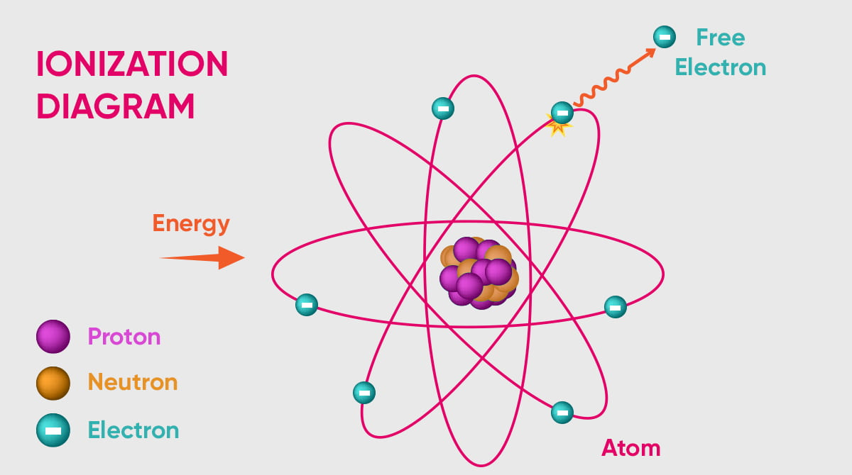
Basic Radiation Concepts
People are continuously exposed to radiation. Radiation, simply defined, is energy emitted through space and matter. Radiation is the emission of particles or waves of energy from unstable atoms. These energetic, invisible particles or waves can injure living organisms under certain conditions.
Examples of ionizing radiation include particles (alpha, beta, or neutron radiation) or a rays (gamma or x-ray).
Notes:
People are continuously exposed to radiation. Radiation, simply defined, is energy emitted through space and matter. Radiation is the emission of particles or waves of energy from unstable atoms. These energetic, invisible particles or waves can injure living organisms under certain conditions. Examples of ionizing radiation, which are energetic enough to remove electrons from an atom, include particles (alpha, beta, or neutron radiation) or a rays (gamma or x-ray).

Slide 6
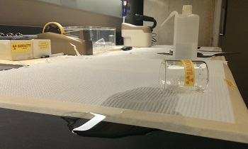
Radioactive Contamination
Another term associated with radiation is radioactive contamination. Radioactive contamination is having radioactive material in an unwanted location. Radioactive contamination is strictly controlled at WSU to prevent its spread.
Notes:
Another term associated with radiation is radioactive contamination. Radioactive contamination is having radioactive material in an unwanted location. Radioactive contamination is strictly controlled at WSU to prevent its spread.

Slide 7
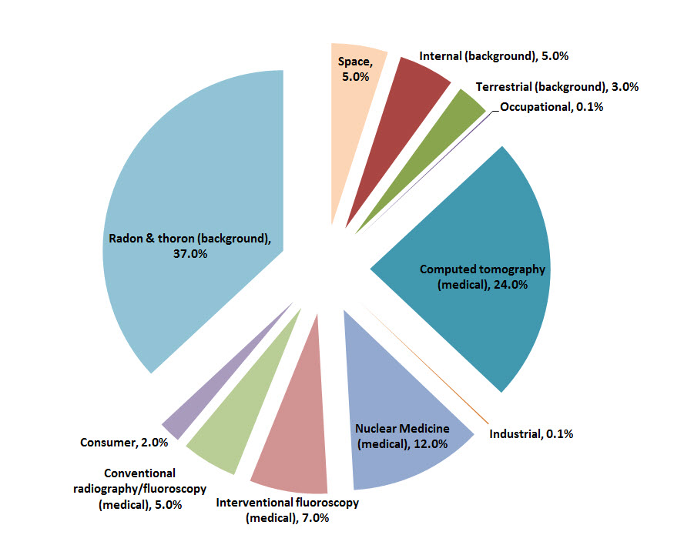
Background Radiation
According to the National Council on Radiation Protection and Measurement (NCRP) Report 106, individuals in the U.S receive 620 mrem (6.2 mSv) per year from natural background radiation and manmade radiation.¹
¹ Figure reproduced from NCRP, 2009. Ionizing Radiation Exposure of the Population of the United States. NCRP Report No. 106. Bethesda, MD. March 3, 2009.
Notes:
Everyone is exposed to radiation daily. Natural radiation is present in the environment includes cosmic radiation, terrestrial radiation, and internal radiation existing in all living things. Individuals are also exposed to man-made sources of radiation from medical use, commercial products, industrial applications, nuclear power, and atmospheric testing. According to the National Council on Radiation Protection and Measurement (NCRP) Report 106, individuals in the U.S receive 620 mrem (6.2 mSv) per year from natural background radiation and manmade radiation. The mrem is the unit used to measure dose received by an individual. As a non-radiation worker, you are allowed to receive an additional 100 mrem/year, which is considered to be within the normal range of the public’s risk tolerance.

Slide 8

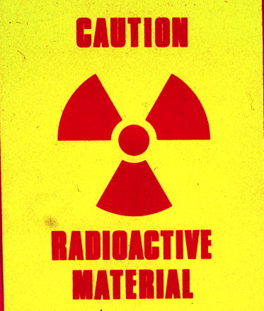
Coordination With Radiation Safety Program Staff And Facilities
Occasionally non-radiation workers may need to operate in a radioactive materials area or on a piece of equipment that contains or has contained radioactive materials.
Jobs involving areas or items where radiation hazards may exist:
Servicing refrigerators
Servicing ventilation systems
Servicing plumbing
General housekeeping
Notes:
Occasionally non-radiation workers may need to operate in a radioactive materials area or on a piece of equipment that contains or has contained radioactive materials. Jobs involving areas or items where radiation hazards may exist:
Jobs involving areas or items where radiation hazards may exist:
Servicing refrigerators
Servicing ventilation systems
Servicing plumbing
General housekeeping

Slide 9
Non-radiation Worker Rights and Responsibilities
Be aware of all radiological posting and radioactive material labeled areas and equipment.
Do not enter an area containing radioactive material or radiation producing devices without approval by the Authorized User or Laboratory Supervisor.
Do not perform tasks for which you do not have training.
Do not remove radioactive material, radioactive waste, or devices from laboratory.
Report water discovered on the floor of a laboratory using radioactive material to the Radiation Safety Program.
Notes:
Know your rights and responsibilities as a non-radiation worker.
Be aware of all radiological posting and radioactive material labeled areas and equipment.
Do not enter an area containing radioactive material or radiation producing devices without approval by the Authorized User or Laboratory Supervisor.
Do not perform tasks for which you do not have training.
Do not remove radioactive material, radioactive waste, or devices from laboratory.
Report water discovered on the floor of a laboratory using radioactive material to the Radiation Safety Program.

Slide 10
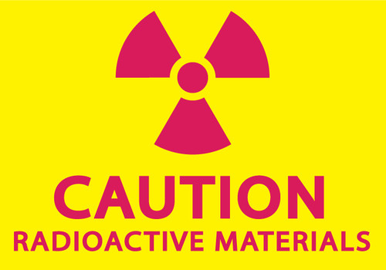
How Do I Identify Radioactive Material?
All radiological hazards at WSU are easily identifiable with postings and labels containing a black or magenta trefoil on a yellow background with the words “Caution” or “Danger.”
A radioactive material sign is posted on all laboratories authorized for radioactive material use.
The words “CAUTION RADIOACTIVE MATERIALS” are used to indicate the known or potential contamination of a lab item or area.
DO NOT remove radioactive material postings.
Notes:
Non-radiation workers may routine encounter barriers, postings, radiation producing devices, or radioactive materials.
All radiological hazards at WSU are easily identifiable with postings and labels containing a black or magenta trefoil on a yellow background with the words “Caution” or “Danger.”
A radioactive material sign is posted on all laboratories authorized for radioactive material use.
The words “CAUTION RADIOACTIVE MATERIALS” are used to indicate the known or potential contamination of a lab item or area.
DO NOT remove radioactive material postings.

Slide 11
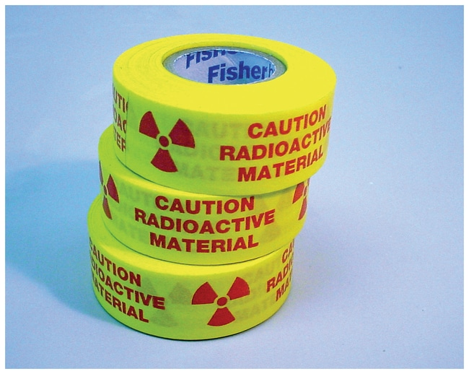

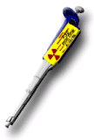
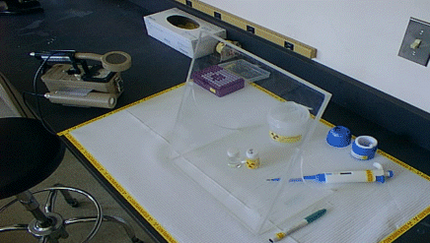
Radioactive Material Labels
Radioactive material labels are used to communicate contamination hazards.
Containers and tools containing or contacting radioactive materials and worker areas where radioactive materials are handled are labeled.
DO NOT handle items with radioactive material labels.
DO NOT remove radioactive material labels or stickers.
DO NOT remove labeled items from the laboratory.
Report radioactive material labels or stickers found in the routine trash.
Notes:
Radioactive material labels are used to communicate contamination hazards.
Containers and tools containing or contacting radioactive materials and worker areas where radioactive materials are handled are labeled.
DO NOT handle items with radioactive material labels.
DO NOT remove radioactive material labels or stickers.
DO NOT remove labeled items from the laboratory.
Report radioactive material labels or stickers found in the routine trash.

Slide 12
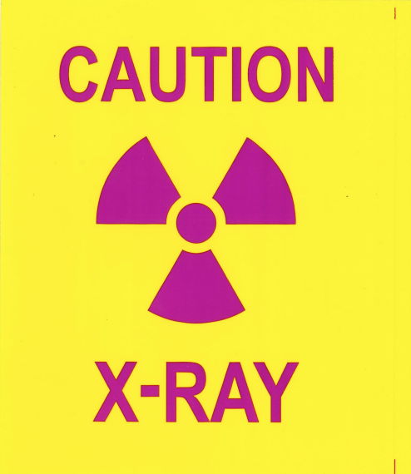
How Do I Identify Radiation Producing Machines?
This sign is posted on all laboratories authorized for x-ray use.
The words “CAUTION X-RAY” are used to indicate the known or potential hazard of a lab item or area.
Do not remove X-ray postings, manufacturing labels, or temporary labels on equipment.
Notes:
This sign is posted on all laboratories authorized for x-ray use.
The words “CAUTION X-RAY” are used to indicate the known or potential hazard of a lab item or area.
Do not remove X-ray postings, manufacturing labels, or temporary labels on equipment.

Slide 13
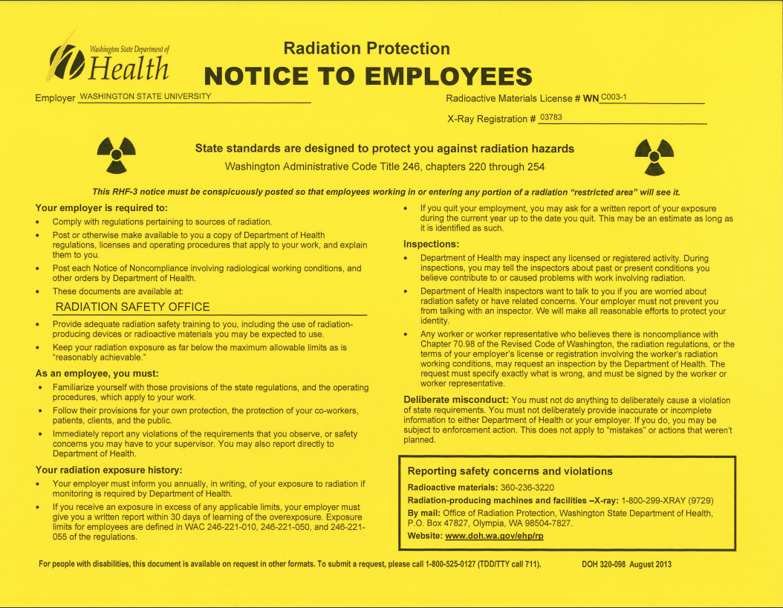
Notice to Employees
You have the right to notify the Washington State Department of Health (DOH) if you suspect improper actions by the University, or conditions which may to the violation of regulations or unnecessary exposure to radiation.
A Notice to Employees (Form RHF-3) is posted in each laboratory or area authorized for radioactive material use or radiation producing device.
This form provides contact information for the Washington State DOH, the agency that regulates the use of Radioactive Materials in Washington.
Your responsibilities and rights are listed on this form.
Notes:
You have the right to notify the Washington State Department of Health (DOH) if you suspect improper actions by the University, or conditions which may to the violation of regulations or unnecessary exposure to radiation.
A Notice to Employees (Form RHF-3) is posted in each laboratory or area authorized for radioactive material use or radiation producing device.
This form provides contact information for the Washington State DOH, the agency that regulates the use of Radioactive Materials in Washington.
Your responsibilities and rights are listed on this form.

Slide 14
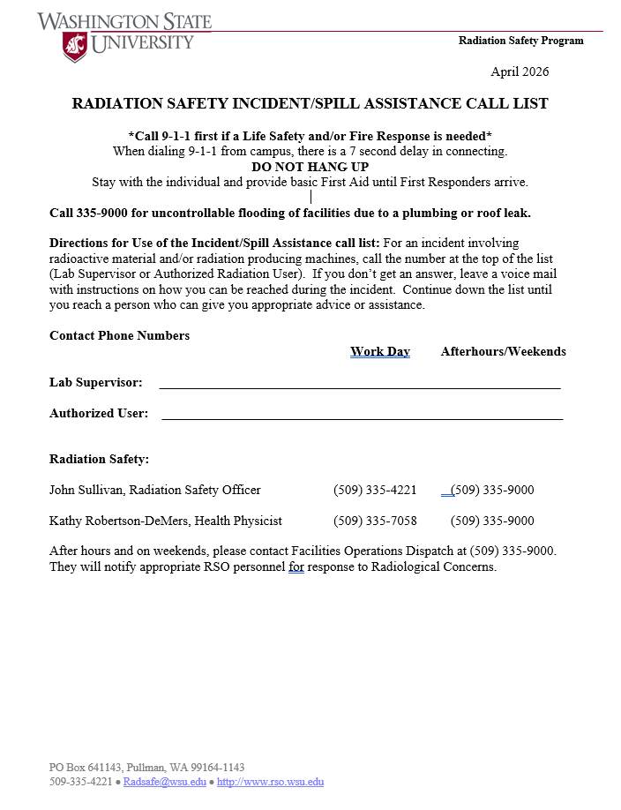
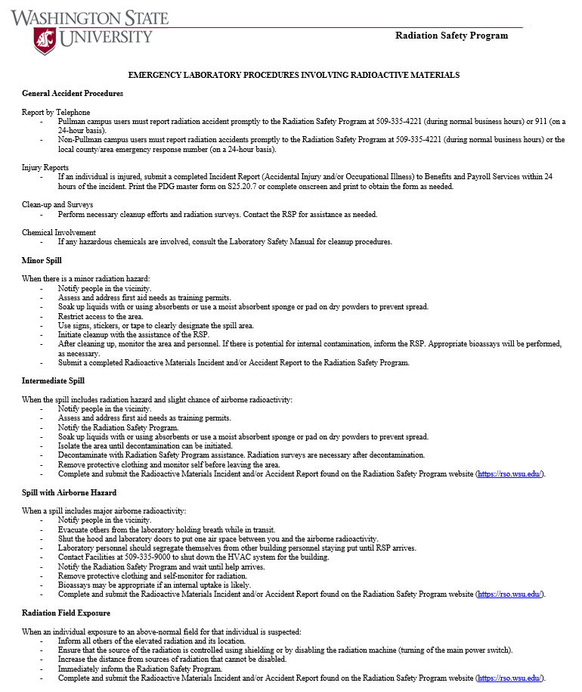
Emergency Contact Information Lab Postings
Radiation Safety Incident/Spill Assistance Call List
Emergency Lab Procedures Involving Radioactive Materials
Notes:
Emergency contact information and emergency laboratory procedures for incidents involving radiation exposure or radioactive materials are posted in each laboratory.

Slide 15
Incidents/Spill Assistance
If Life Safety and/or Fire Response is needed, dial 911 first
Do not hang up until First Responders arrive, provide basic first aid
For uncontrollable flooding from a plumbing or roof leak, contact WSU Facilities at 509-335-9000
For incidents involving radioactive materials or radiation producing machines contact the Lab Supervisor or Authorized User and Radiation Safety Program personnel. Contact information is posted in the lab or online at rso.wsu.edu/contacts/.
Incidents that occur after hours and on weekends, contact Facilities Dispatch at 509-335-9000. They will notify appropriate RSP personnel.
Emergency contact information is posted in the lab or area containing radiation producing devices.
Do not hesitate to report radioactive material spills!
Report water found on the floor of a laboratory using radioactive material to RSP.
Notes:
If there is a life safety and/or fire response emergency Call 9-1-1. Do not hang up and provide basic first aide to injured individuals until First Responders arrive. Stay with injured individuals and provide basic first aide until First Responders arrive. For uncontrollable flooding from a plumbing or roof leak, contact WSU Facilities at 509-335-9000. For incidents involving radioactive materials or radiation producing machines contact the Lab Supervisor or Authorized User, then contact Radiation Safety personnel. Contact information is posted in your lab.). If you don’t get an answer, leave a voice mail with instructions on how you can be reached during the incident. Continue down the list until you reach a person who can give you appropriate advice or assistance. Incidents that occur after hours and on weekends, contact Facilities Dispatch at 509-335-9000. They will notify appropriate RSP personnel. You will also find an Emergency Laboratory Spill Procedure Involving Radioactive Materials posting that provides directions on addressing spills and unexpected radiation exposure. Follow the directions of trained radiation workers. Do not hesitate to report radioactive material spills! Report water found on the floor of a laboratory using radioactive material to the Radiation Safety Program.

Slide 16
Radiation Protection Principles
The key to managing radiological risks is to keep exposures to radiation and other hazardous materials “As Low As Reasonably Achievable” or ALARA.
The cornerstone of the ALARA philosophy is to evaluate all hazards before conducing work and ensure appropriate controls are present. The main ALARA principles are:
Reduce TIME near the hazard.
Increase the DISTANCE from the hazard.
Increase the SHEILDING between you and the hazard.
AVOID or MINIMIZE exposure to radioactive material.
Notes:
The key to managing radiological risks is to keep exposures to radiation “As Low As Reasonably Achievable” or ALARA. The cornerstone of the ALARA philosophy is to evaluate all hazards before conducing radiological work and ensuring appropriate engineering controls (e.g., shielding, proper ventilation, use of hoods and gloveboxes) and administrative controls (e.g., warning signs, procedures) are in place. These controls are established by the Authorized User in conjunction with the Radiation Safety Program. While you are working around radiation, do your part to follow the main ALARA principles:
- Reduce TIME near the hazard. The less time spent near the source of radiation the less exposure received.
- Increase the DISTANCE from the hazard. Doubling the distance from a source reduces the dose factor by four.
- Increase the SHEILDING between you and the hazard. The presence of shielding between the radiation source and the individual will reduce exposure.
- AVOID or MINIMIZE exposure to radioactive material, which will reduce the likelihood of radioactive contamination.

Slide 17

Decreasing Exposure to Radioactive Contamination
DO NOT eat, drink, smoke, chew, or apply cosmetics in radiation workspaces.
DO NOT store food, drink or personal effects (jewelry, toiletries, and other personal items) in any area container, or refrigerator designated for radioactive materials use or storage.
Wear appropriate personal protective equipment for the laboratory or area.
Change gloves frequently and remove them before leaving the lab. Never put potentially contaminated gloves in regular trash.
Monitor hands, clothes and tools frequently after working around radioactive materials. Radiation workers can assist you.
Always wash your hands at the completion of work around radioactive materials.
Notes:
Ask the Authorized User or Laboratory Supervisor for an orientation of the laboratory or area and the location of the radioactive material that may be encountered.
DO NOT eat, drink, smoke, chew, or apply cosmetics in radiation workspaces.
DO NOT store food, drink or personal effects (jewelry, toiletries, and other personal items) in any area container, or refrigerator designated for radioactive materials use or storage.
Wear appropriate personal protective equipment for the laboratory or area.
Change gloves frequently and remove them before leaving the lab. Never put potentially contaminated gloves in regular trash.
Monitor hands, clothes and tools frequently after working around radioactive materials. Radiation workers can assist you.
Always wash your hands at the completion of work around radioactive materials.

Slide 18
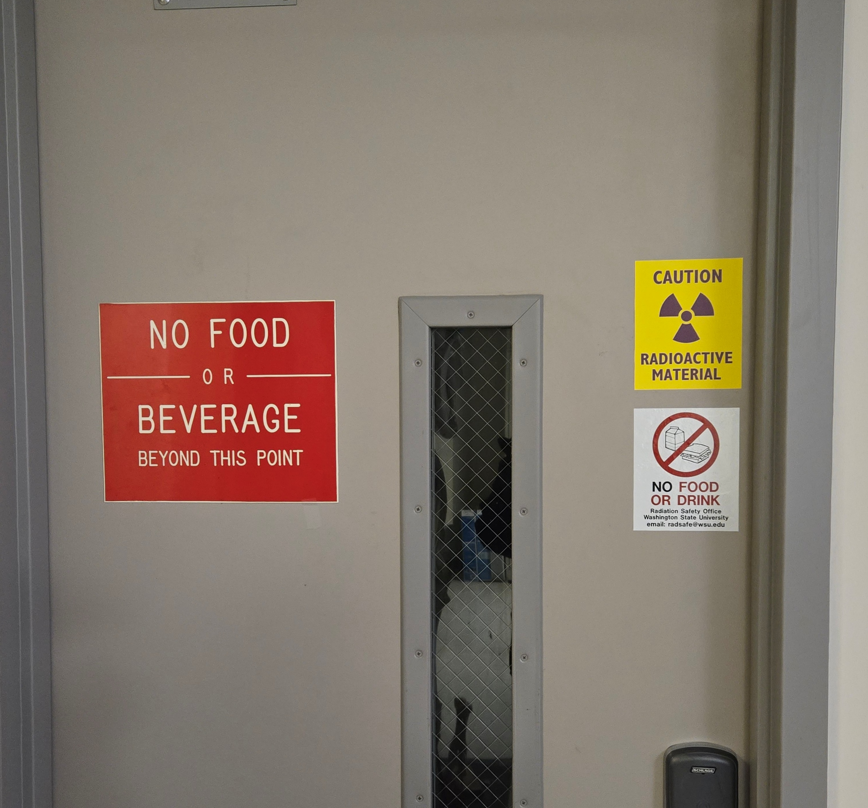
Security and Control of Radioactive Material and Radiation Producing Machines
Licensed radioactive material and registered radiation producing machines must be secured and controlled to prevent unauthorized assess or removal from the place of storage.
DO NOT enter areas with radioactive material or radiation producing machines without the authorization of the Authorized User or Laboratory Supervisor. If an area has a radioactive material sign, assume radioactive material is present.
Licensed radioactive materials in an unrestricted area and not in storage shall be under the constant surveillance and immediate control of the user.
If you find unattended radioactive material, do not handle the material and notify the RSP staff.
Notes:
Licensed radioactive material and registered radiation producing machines must be secured and controlled to prevent unauthorized assess or removal from the place of storage.
DO NOT enter areas with radioactive material or radiation producing machines without the authorization of the Authorized User or Laboratory Supervisor. If an area has a radioactive material sign, assume radioactive material is present.
Licensed radioactive materials in an unrestricted area and not in storage shall be under the constant surveillance and immediate control of the user.
If you find unattended radioactive material, do not handle the material and notify the RSP staff.

Slide 19
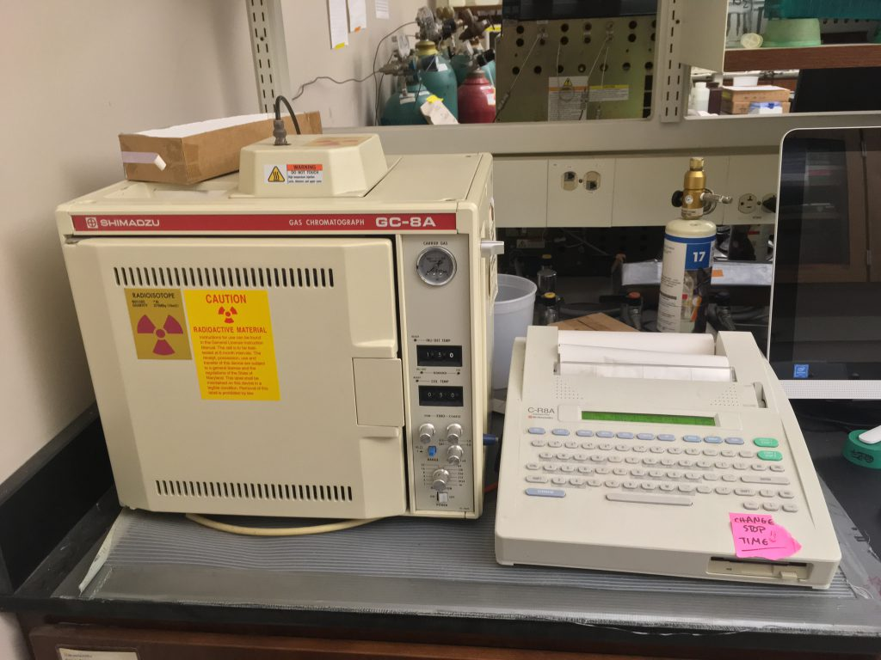
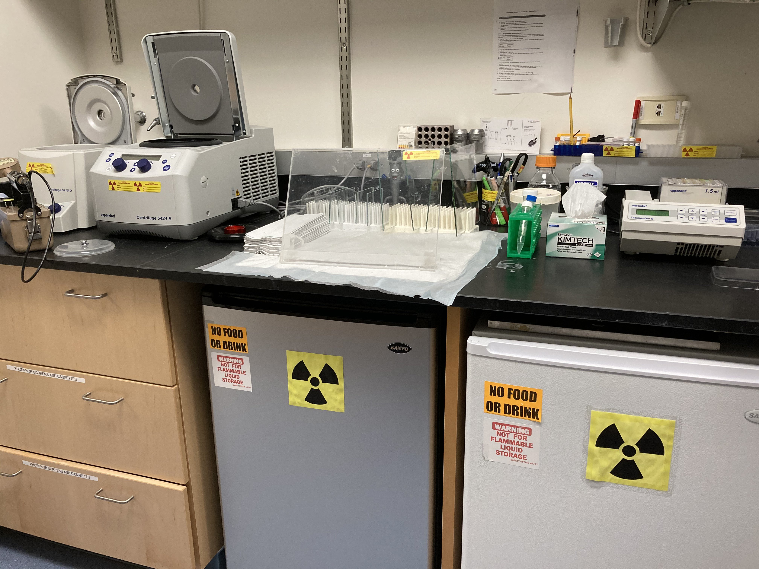
Process for Servicing Equipment or Facilities
Contact RSP regarding the need to service equipment or facilities at radsafe@wsu.edu.
If you are uncertain whether equipment contains or contained radioactive sources or material, consult with the Authorized User or Laboratory Supervisor.
Ensure Authorized User or Laboratory Supervisor surveys and decontaminates equipment used with radioactive materials prior to servicing or disposition of equipment.
The Radiation Safety Program staff will perform property release surveys prior to the transfer of equipment to Surplus Stores or release for unrestricted use. At non-Pullman campuses and Research Stations RSP staff will review the surveys conducted by the authorized users to confirm the equipment and/or area is contamination free.
Notes:
When you have the need to service equipment and facilities:
Contact RSP regarding the need to service equipment or facilities at radsafe@wsu.edu.
If you are uncertain whether equipment contains or contained radioactive sources or material, consult with the Authorized User or Laboratory Supervisor.
Ensure Authorized User or Laboratory Supervisor surveys and decontaminates equipment used with radioactive materials prior to servicing or disposition of equipment.
The Radiation Safety Program staff will perform property release surveys prior to the transfer of equipment to Surplus Stores or release for unrestricted use. At non-Pullman campuses and Research Stations RSP staff will review the surveys conducted by the authorized users to confirm the equipment and/or area is contamination free.

Slide 20
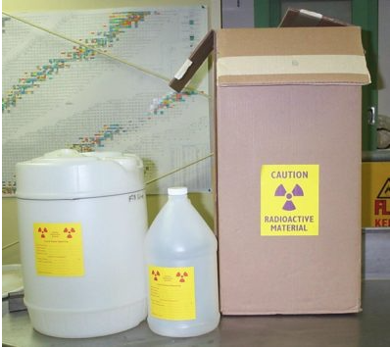
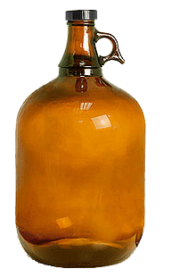

Housekeeping and Waste Containers
The Radiation Safety Program supplies radioactive waste containers to users.
One or two cubic foot cardboard boxes are used dry radioactive waste and lab trash.
One and five gallon jugs can be purchased by the lab for mixed and aqueous liquid wastes.
*Glass bottles may not be used for liquid waste.
Waste containers have a “Caution Radioactive Material” label affixed to the container.
DO NOT remove radioactive waste containers from the laboratory.
Outer Radioactive Materials shipping containers (boxes) may be discarded as NORMAL trash only after they have been surveyed and found free of contamination and all radioactive labels are defaced.
Notes:
The Radiation Safety Program supplies radioactive waste containers to users.
One or two cubic foot cardboard boxes are used dry radioactive waste and lab trash.
One and five gallon jugs can be purchased by the lab for mixed and aqueous liquid wastes.
*Glass bottles may not be used for liquid waste.
Waste containers have a “Caution Radioactive Material” label affixed to the container.
DO NOT remove radioactive waste containers from the laboratory.
Outer Radioactive Materials shipping containers (boxes) may be discarded as NORMAL trash only after they have been surveyed and found free of contamination and all radioactive labels are defaced.

Slide 21
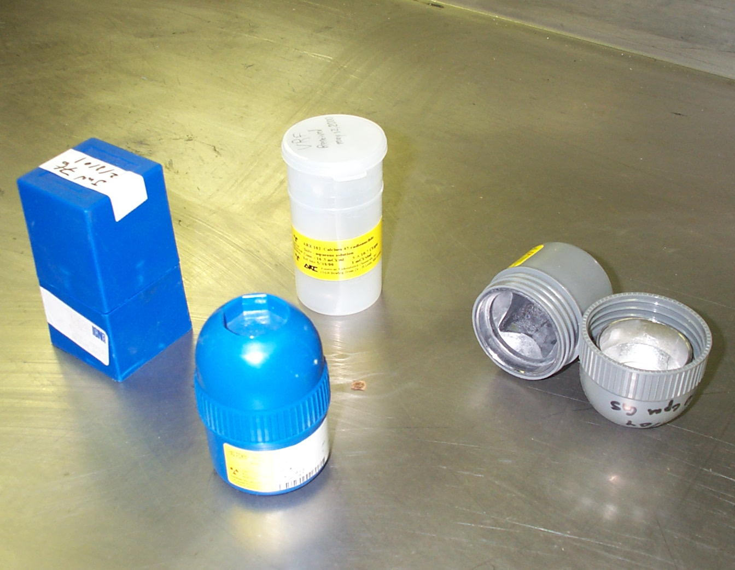
Waste Containers
Plastic inner shipping container (blue pigs) may also be discarded as NORMAL trash only after they have been surveyed and found free of contamination, and all radioactive are labels defaced.
Lead pigs (gray) are considered hazardous and may not be discarded in the normal trash. EH&S or RSP staff will collect these pigs.
Notes:
“

Slide 22

Thank You!
Thank you for completing the General Employee Radiation Training!
If you have any questions, contact the Radiation Safety Program at radsafe@wsu.edu.
Notes:
Thank you for completing the General Employee Radiation Training!

