Slide 1
Radiation Awareness Training
Washington State University Radiation Safety Program

Slide 2
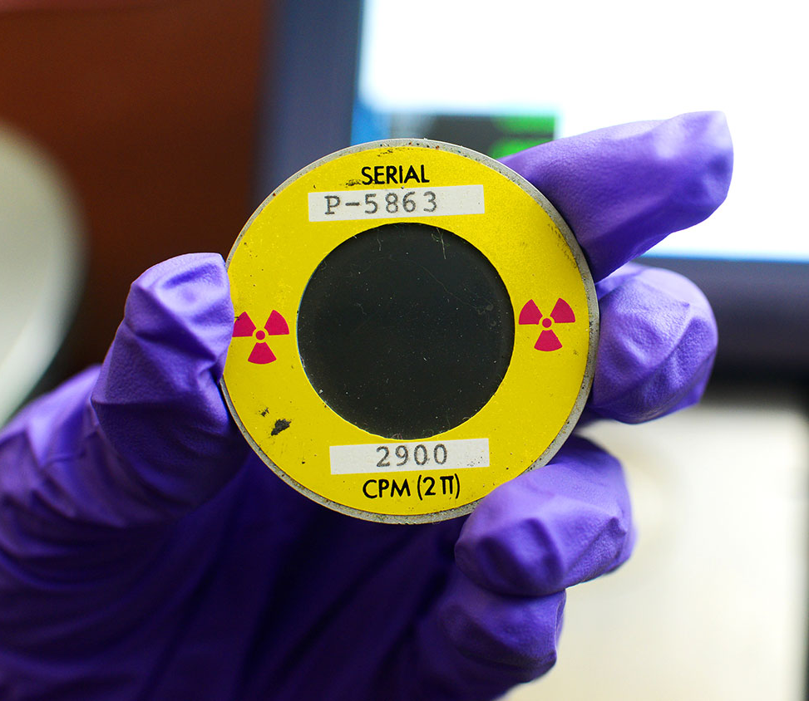
Welcome to Radiation Awareness Training
Welcome to Radiation Awareness Training!
This training is provided to all auxiliary personnel who access laboratories and clinical areas where radioactive material or radiation producing devices are present.
This training does not authorize you to work directly with radioactive material or operate radiation producing devices.
This presentation will provide you with essential information to identify radiological hazards and ensure your safety, health, and well-being when entering areas where radioactive material (RAM) or radiation producing devices are used.
Notes:
Welcome to Radiation Awareness Training! This training is provided to all auxiliary personnel who access laboratories and clinical areas where radioactive material or radiation producing devices are present. This training does not authorize you to work directly with radioactive material or operate radiation producing devices. This presentation will provide you with essential information to identify radiological hazards and ensure your safety, health, and well-being when entering areas where radioactive material (RAM) or radiation producing devices are used.

Slide 3
Non-radiation Worker Rights and Responsibilities
Be aware of all radiological posting and radioactive material labeled areas and equipment.
Do not enter an area containing radioactive material or radiation producing devices without approval by the Authorized User or Laboratory Supervisor.
Do not perform tasks for which you do not have training.
Do not remove radioactive material, radioactive waste, or devices from laboratory.
Report water discovered on the floor of a laboratory using radioactive material to the Radiation Safety Program.
Notes:
Know your rights and responsibilities as a non-radiation worker.
Be aware of all radiological posting and radioactive material labeled areas and equipment.
Do not enter an area containing radioactive material or radiation producing devices without approval by the Authorized User or Laboratory Supervisor.
Do not perform tasks for which you do not have training.
Do not remove radioactive material, radioactive waste, or devices from laboratory.
Report water discovered on the floor of a laboratory using radioactive material to the Radiation Safety Program.

Slide 4
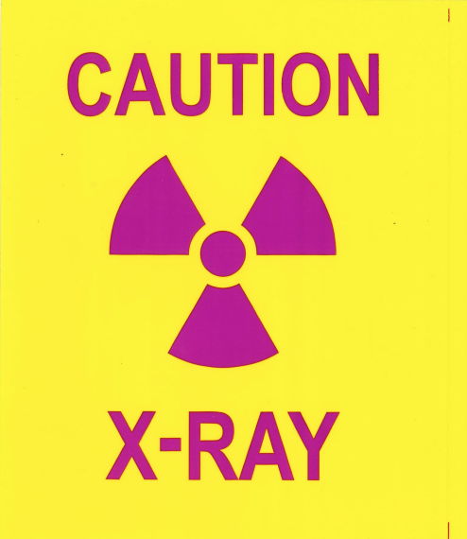
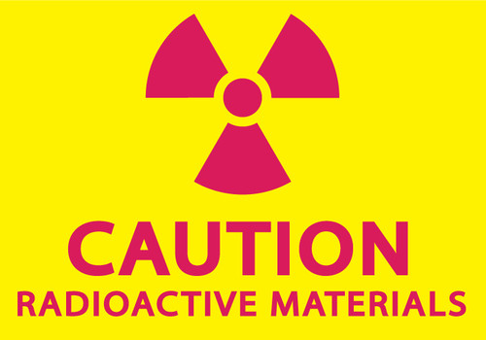
How Do I Identify Areas with Radiation?
All radiological hazards at WSU are easily identifiable with postings and labels containing a black or magenta trefoil on a yellow background with the words “Caution” or “Danger.”
DO NOT remove radioactive material postings.
Radioactive Materials
Radiation Producing Machines
Notes:
Non-radiation workers may routine encounter barriers, postings, radiation producing devices, or radioactive materials. All radiological hazards at WSU are easily identifiable with postings and labels containing a black or magenta trefoil on a yellow background with the words “Caution” or “Danger.” A radioactive material sign is posted on all laboratories and clinical areas authorized for radioactive material or radiation producing machine use. The words “CAUTION RADIOACTIVE MATERIALS” are used to indicate the known or potential contamination of a lab item or area. Radiation producing machines encountered at WSU are x-ray producing. These areas are posted with a sign with the “CAUTION X-RAY.”
DO NOT remove radioactive material postings.

Slide 5
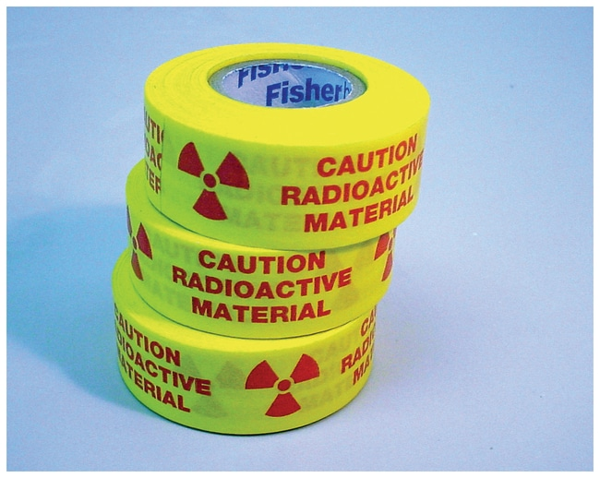

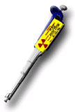
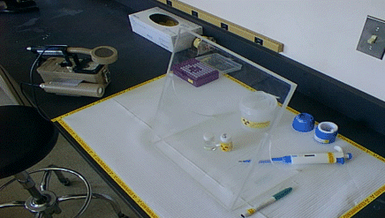
Radioactive Material Labels
Radioactive material labels are used to communicate contamination hazards.
Containers and tools containing or contacting radioactive materials and worker areas where radioactive materials are handled are labeled.
DO NOT handle items with radioactive material labels.
DO NOT remove radioactive material labels or stickers.
DO NOT remove labeled items from the laboratory.
Report radioactive material labels or stickers found in the routine trash.
Notes:
Radioactive material labels are used to communicate contamination hazards.
Containers and tools containing or contacting radioactive materials and worker areas where radioactive materials are handled are labeled.
DO NOT handle items with radioactive material labels.
DO NOT remove radioactive material labels or stickers.
DO NOT remove labeled items from the laboratory.
Report radioactive material labels or stickers found in the routine trash.

Slide 6

Decreasing Exposure to Radioactive Contamination
DO NOT eat, drink, smoke, chew, or apply cosmetics in radiation workspaces.
DO NOT store food, drink or personal effects (jewelry, toiletries, and other personal items) in any area container, or refrigerator designated for radioactive materials use or storage.
Wear appropriate personal protective equipment for the laboratory or area.
Change gloves frequently and remove them before leaving the lab. Never put potentially contaminated gloves in regular trash.
Monitor hands, clothes and tools frequently after working around radioactive materials with the assistance of a radiation worker.
Always wash your hands at the completion of work around radioactive materials.
Notes:
Ask the Authorized User or Laboratory Supervisor for an orientation of the laboratory or area and the location of the radioactive material that may be encountered.
DO NOT eat, drink, smoke, chew, or apply cosmetics in radiation workspaces.
DO NOT store food, drink or personal effects (jewelry, toiletries, and other personal items) in any area container, or refrigerator designated for radioactive materials use or storage.
Wear appropriate personal protective equipment for the laboratory or area.
Change gloves frequently and remove them before leaving the lab. Never put potentially contaminated gloves in regular trash.
Monitor hands, clothes and tools frequently after working around radioactive materials with the assistance of a radiation worker.
Always wash your hands at the completion of work around radioactive materials.

Slide 7
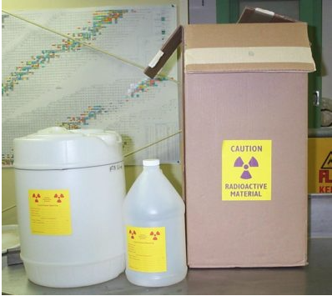
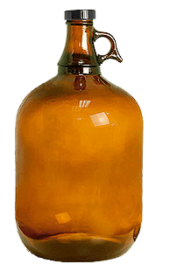

Housekeeping and Waste Containers
The Radiation Safety Program supplies radioactive waste containers to users.
One or two cubic foot cardboard boxes are used dry radioactive waste and lab trash.
One and five gallon jugs can be purchased by the lab for mixed and aqueous liquid wastes.
*Glass bottles may not be used for liquid waste.
Waste containers have a “Caution Radioactive Material” label affixed to the container.
DO NOT remove radioactive waste containers from the laboratory.
Outer Radioactive Materials shipping containers (boxes) may be discarded as NORMAL trash only after they have been surveyed and found free of contamination and all radioactive labels are defaced.
Notes:
The Radiation Safety Program supplies radioactive waste containers to users.
One or two cubic foot cardboard boxes are used dry radioactive waste and lab trash.
One and five gallon jugs can be purchased by the lab for mixed and aqueous liquid wastes.
*Glass bottles may not be used for liquid waste.
Waste containers have a “Caution Radioactive Material” label affixed to the container.
DO NOT remove radioactive waste containers from the laboratory.
Outer Radioactive Materials shipping containers (boxes) may be discarded as NORMAL trash only after they have been surveyed and found free of contamination and all radioactive labels are defaced.

Slide 8
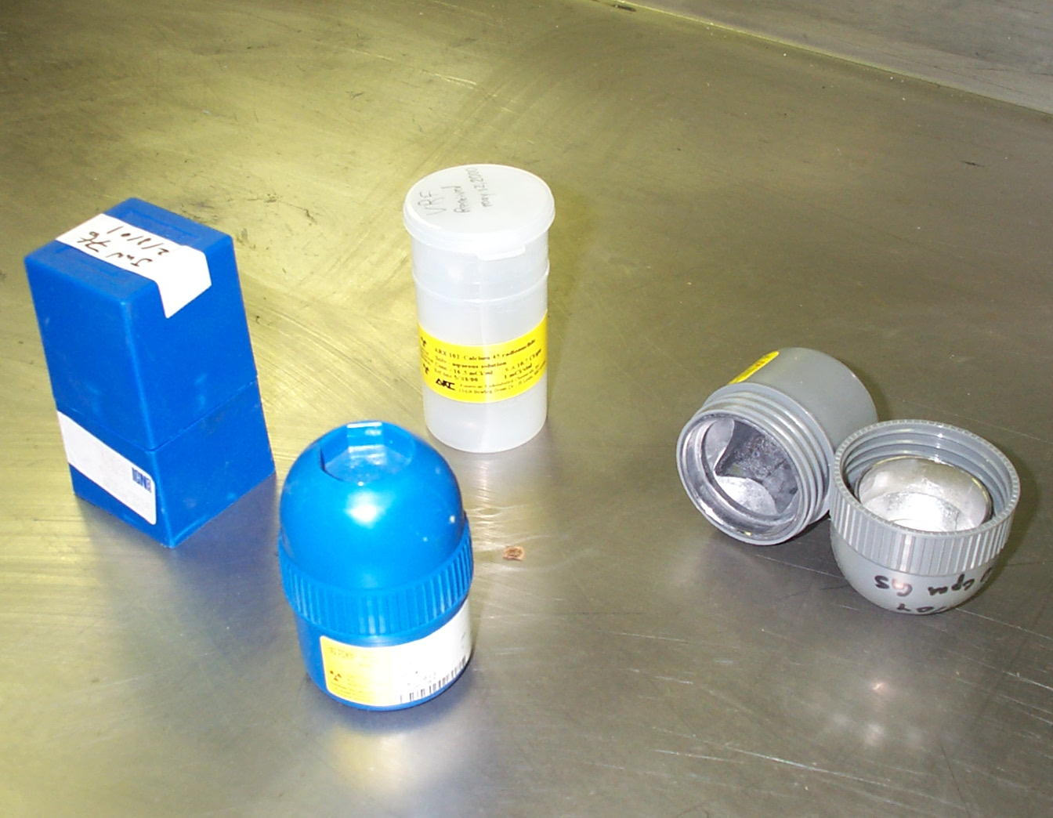
Waste Containers
Plastic inner shipping container (blue pigs) may also be discarded as NORMAL trash only after they have been surveyed and found free of contamination, and all radioactive are labels defaced.
Lead pigs (gray) are considered hazardous and may not be discarded in the normal trash. EH&S or RSP staff will collect these pigs.
Notes:
Plastic inner shipping container (blue pigs) may also be discarded as NORMAL trash only after they have been surveyed and found free of contamination, and all radioactive are labels defaced.
Lead pigs (gray) are considered hazardous and may not be discarded in the normal trash. EH&S or RSP staff will collect these pigs.

Slide 9
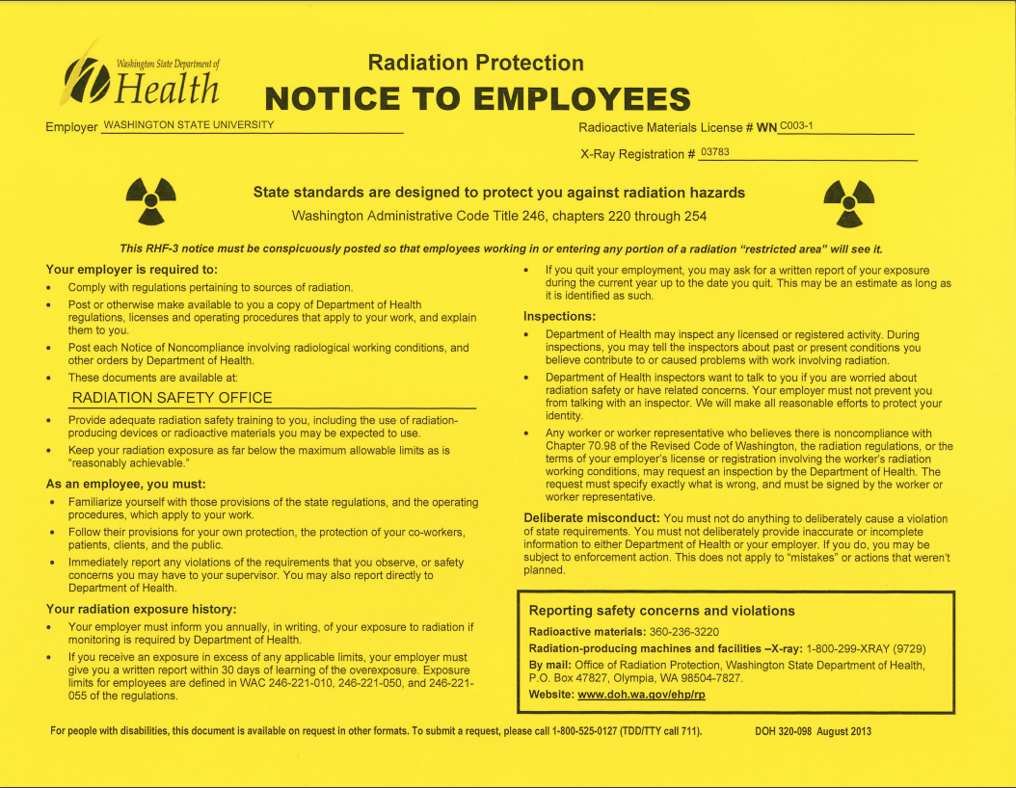
Notice to Employees
You have the right to notify the Washington State Department of Health (DOH) if you suspect improper actions by the University, or conditions which may to the violation of regulations or unnecessary exposure to radiation.
A Notice to Employees (Form RHF-3) is posted in each laboratory or area authorized for radioactive material use or radiation producing device.
This form provides contact information for the Washington State DOH, the agency that regulates the use of Radioactive Materials in Washington.
Your responsibilities and rights are listed on this form.
Notes:
You have the right to notify the Washington State Department of Health (DOH) if you suspect improper actions by the University, or conditions which may to the violation of regulations or unnecessary exposure to radiation.
A Notice to Employees (Form RHF-3) is posted in each laboratory or area authorized for radioactive material use or radiation producing device.
This form provides contact information for the Washington State DOH, the agency that regulates the use of Radioactive Materials in Washington.
Your responsibilities and rights are listed on this form.

Slide 10
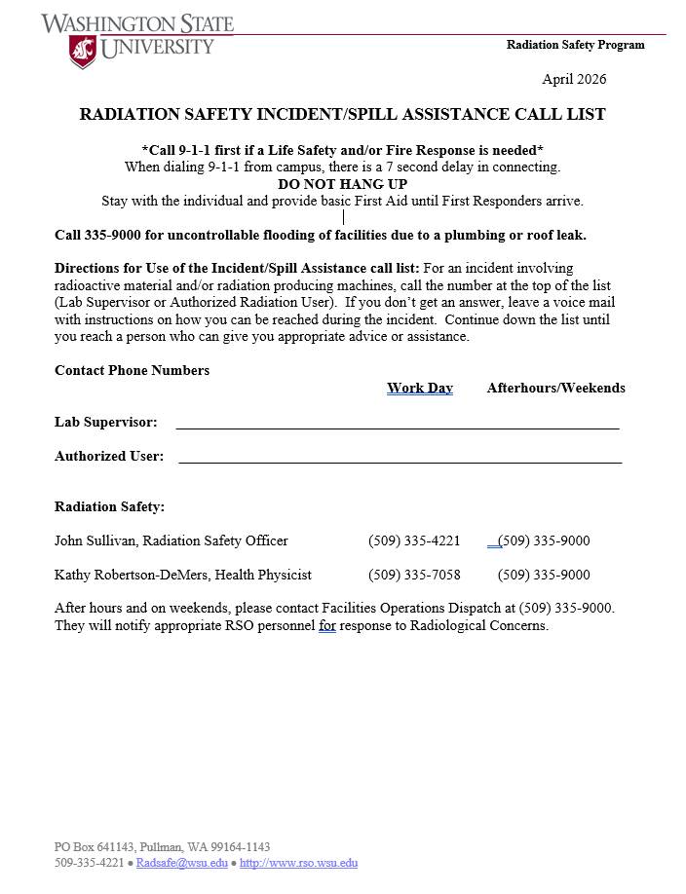
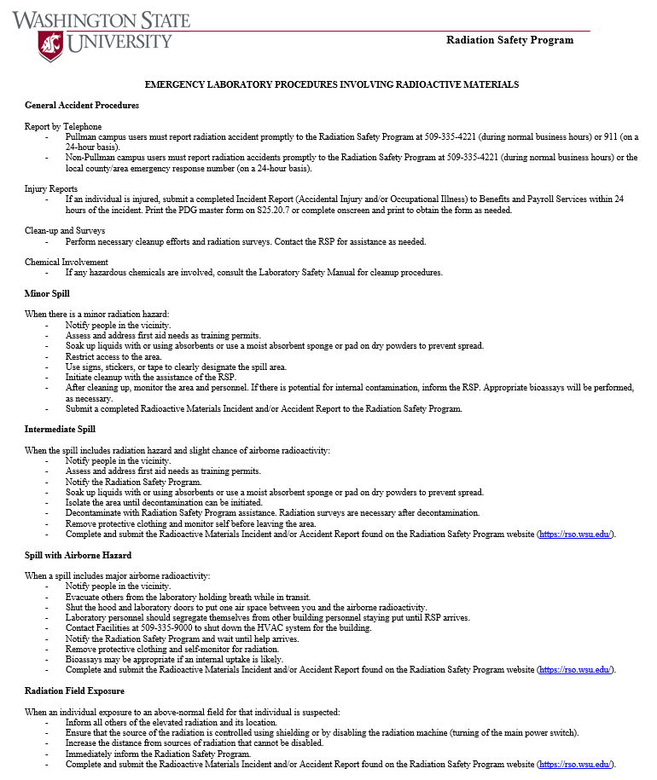
Emergency Contact Information Lab Postings
Radiation Safety Incident/Spill Assistance Call List
Emergency Lab Procedures Involving Radioactive Materials
Notes:
Emergency contact information and emergency laboratory procedures for incidents involving radiation exposure or radioactive materials are posted in each laboratory.

Slide 11
Incidents/Spill Assistance
If Life Safety and/or Fire Response is needed, dial 911 first
Do not hang up until First Responders arrive, provide basic first aid
For uncontrollable flooding from a plumbing or roof leak, contact WSU Facilities at 509-335-9000
For incidents involving radioactive materials or radiation producing machines contact the Lab Supervisor or Authorized User and Radiation Safety Program personnel. Contact information is posted in the lab or online at rso.wsu.edu/contacts/.
Incidents that occur after hours and on weekends, contact Facilities Dispatch at 509-335-9000. They will notify appropriate RSP personnel.
Emergency contact information is posted in the lab or area containing radiation producing devices.
Do not hesitate to report radioactive material spills!
Report water found on the floor of a laboratory using radioactive material to RSP.
Notes:
If there is a life safety and/or fire response emergency Call 9-1-1. Do not hang up and provide basic first aide to injured individuals until First Responders arrive. Stay with injured individuals and provide basic first aide until First Responders arrive. For uncontrollable flooding from a plumbing or roof leak, contact WSU Facilities at 509-335-9000. For incidents involving radioactive materials or radiation producing machines contact the Lab Supervisor or Authorized User, then contact Radiation Safety personnel. Contact information is posted in your lab.). If you don’t get an answer, leave a voice mail with instructions on how you can be reached during the incident. Continue down the list until you reach a person who can give you appropriate advice or assistance. Incidents that occur after hours and on weekends, contact Facilities Dispatch at 509-335-9000. They will notify appropriate RSP personnel. You will also find an Emergency Laboratory Spill Procedure Involving Radioactive Materials posting that provides directions on addressing spills and unexpected radiation exposure. Follow the directions of trained radiation workers. Do not hesitate to report radioactive material spills! Report water found on the floor of a laboratory using radioactive material to the Radiation Safety Program.

Slide 12
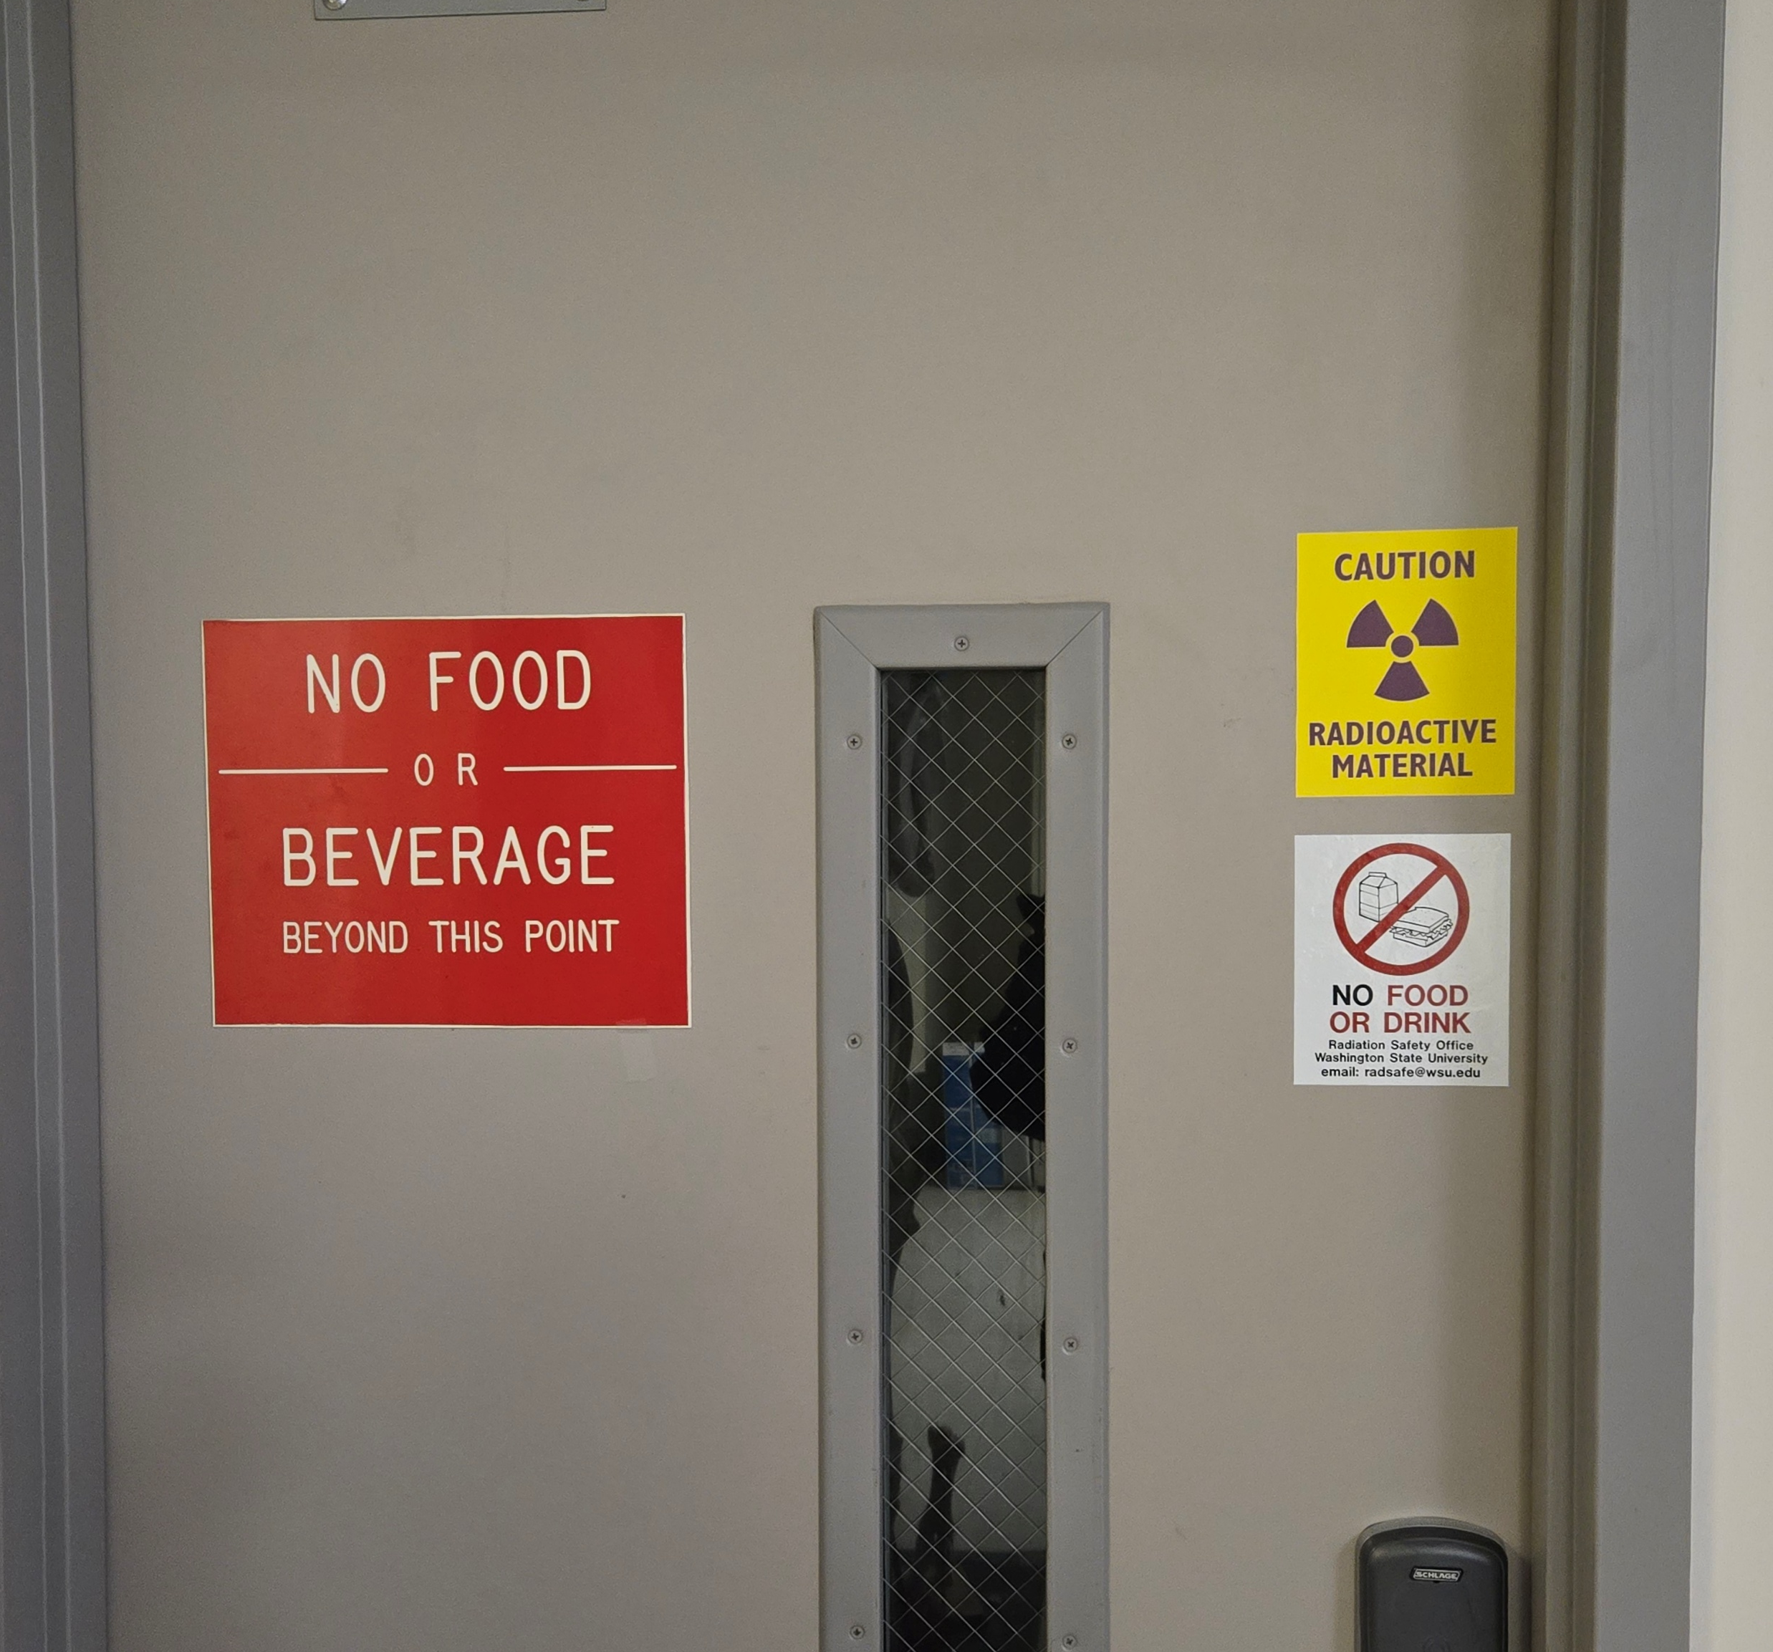
Security and Control of Radioactive Material and Radiation Producing Machines
Licensed radioactive material and registered radiation producing machines must be secured and controlled to prevent unauthorized assess or removal from the place of storage.
DO NOT enter areas with radioactive material or radiation producing machines without the authorization of the Authorized User or Laboratory Supervisor. If an area has a radioactive material sign, assume radioactive material is present.
Licensed radioactive materials in an unrestricted area and not in storage shall be under the constant surveillance and immediate control of the user.
If you find unattended radioactive material, do not handle the material and notify the RSP staff.
Notes:
Licensed radioactive material and registered radiation producing machines must be secured and controlled to prevent unauthorized assess or removal from the place of storage.
DO NOT enter areas with radioactive material or radiation producing machines without the authorization of the Authorized User or Laboratory Supervisor. If an area has a radioactive material sign, assume radioactive material is present.
Licensed radioactive materials in an unrestricted area and not in storage shall be under the constant surveillance and immediate control of the user.
If you find unattended radioactive material, do not handle the material and notify the RSP staff.

Slide 13

Thank You!
Thank you for completing the Radiation AwarenessTraining!
If you have any questions, contact the Radiation Safety Program at radsafe@wsu.edu.
Notes:
Thank you for completing the Radiation Awareness Training! If you have any questions, contact the Radiation Safety Program at radsafe@wsu.edu.

